Slide 1
Thunderbots@Home
Competition Guidelines and Structure
Devon Ash

Slide 2
Outline:
Rules
RoboCup@Home Quick Intro
Technical Requirements
Competition: Stage 1 Details
Competition: Stage 2 Details
Competition: Finals
Updated User Stories
Updated Robot Control Flow Diagram

Slide 3
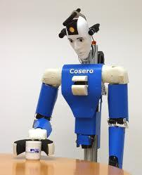
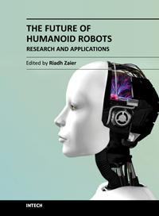





Why did Thunderbots pick @Home?
Learn to build a robot, there’s few (if any) books on building humanoid robots
Connections, networking, friends, partnerships
Contribute to open source projects, publish some papers
Demonstrate that Canada and UBC are capable of competing internationally in the humanoid robotics sector

Slide 4


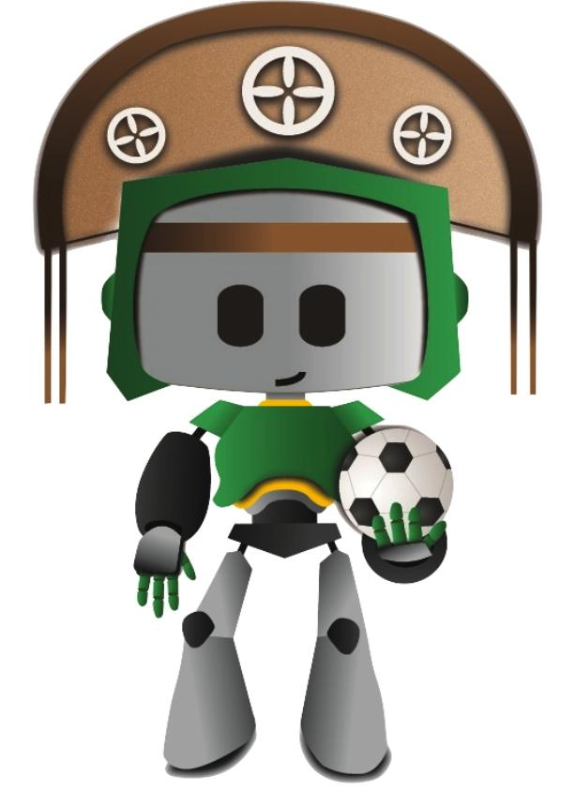

@Home Logistics
Includes symposiums, conferences, workshops, sponsors, industry members, many universities
2014
July, 19-25th
João Pessoa, Brazil
www.robocup2013.org for a good look of what 2014 will be like

Slide 5
@Home Logistics Participants
Uchile HomeBreakers , University of Chile, Chile
Sun , Beijing Information Science & Technology Univ, China
WrightEagle@Home , University of Science and Technology of China, China
BerlinUnited@home , Free University Berlin, Germany
b-it-bots , Bonn-Rhein-Sieg University
Germany
homer@UniKoblenz , University of Koblenz-Landau
Germany
NimbRo@Home , University of Bonn
Germany
ToBI (Team of Bielefeld) , Bielefeld University, Germany
MRL , Qazvin Islamic Azad University
Iran, Islamic Republic of
eR@sers , Tamagawa University, Japan
Pumas , UNAM, National Autonomous University of Mexico, Mexico
Donaxi@HOME , UPAEP, Independent Popular University of the State, Mexico
BORG , University of Groningen, Netherlands
Delft Robotics , Delft University of Technology, Netherlands
Tech United , Eindhoven University of Technology, Netherlands
REEM@IRI , Pompeu Fabra University, Spain
BART LAB AssistBot , Mahidol University, Thailand
Dong Yang , Prince of Songkla University, Thailand
SKUBA , Kasetsart University, Thailand
TRCC , King Mongkut’s University of Technology Thonburi, Thailand

Slide 6
Consistent Teams
er@asers:@Home-participations: JapanOpen2008(1st), RoboCup2008(Champion!!),JapanOpen2009(1st),RoboCup2009(2nd),JapanOpen2010(1st),RoboCup2010(Champion!!)
AllemaniACs:@Home-participations: RoboCup2006(1st), GermanOpen2007(1st), RoboCup2007(1st), GermanOpen2008(1st), RoboCup2008(2nd), RoboCup2009
WrightEagle@Home:@Home Participations: China Open 2009 (2nd), RoboCup 2009, China Open 2010 (1st), RoboCup 2010, RoboCup 2011 (2nd), RoboCup 2012 (4th).
homer@UniKoblenz:Innovation Award at World Championship 2010; RoboCup@Home Technical Challenge Award at World Championship 2012

Slide 7
Rules to know:
No open loops
An open-loop controller, also called a non-feedback controller, is a type of controller that computes its input into a system using only the current state and its model of the system.
A characteristic of the open-loop controller is that it does not use feedback to determine if its output has achieved the desired goal of the input. This means that the system does not observe the output of the processes that it is controlling. Consequently, a true open-loop system can not engage in machine learning and also cannot correct any errors that it could make. It also may not compensate for disturbances in the system.

Slide 8
Rules to know: Open loops
For example, an irrigation sprinkler system, programmed to turn on at set times could be an example of an open-loop system if it does not measure soil moisture as a form of feedback. Even if rain is pouring down on the lawn, the sprinkler system would activate on schedule, wasting water.
Example:

Slide 9
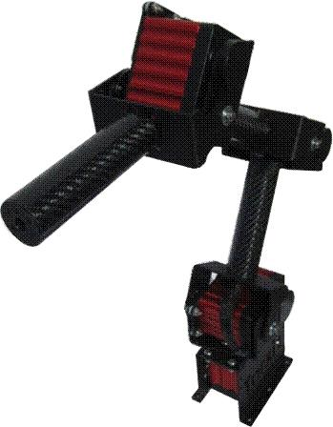
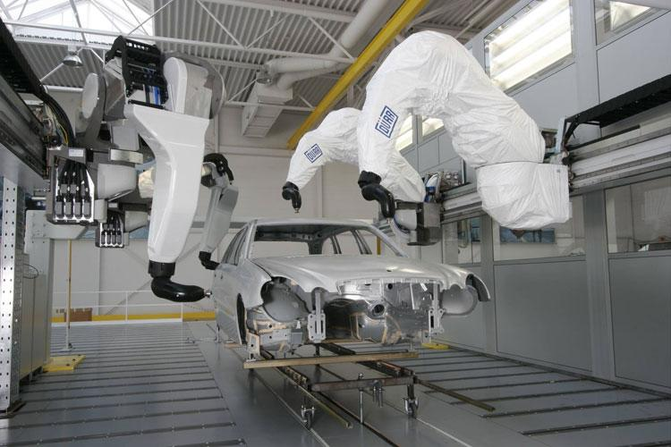
Rules to know: Open loops
What is not open loop:
What is open loop:
Our robot goes into the arena and looks for people, if there are no people there to serve it shouldn’t go through with walking to position (X,Y) and talk to the air
Object to clean-up isn’t there, attempts at picking it up and pretends it is there anyway.
Follows a “person” even when no person is there.

Slide 10
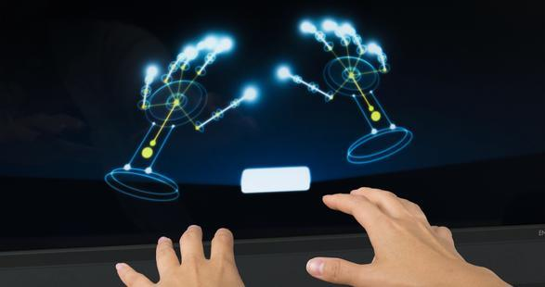
Rules to know: BUT...
Hand gestures may be used to control the robot. No pointing.
Cannot use speech to set it into gesture recognition mode.

Slide 11
Rules to know: Important
IMPORTANT:
We can use natural commands such as gestures and speech to control the robot. Eg for starting, or telling it what task to do.

Slide 12
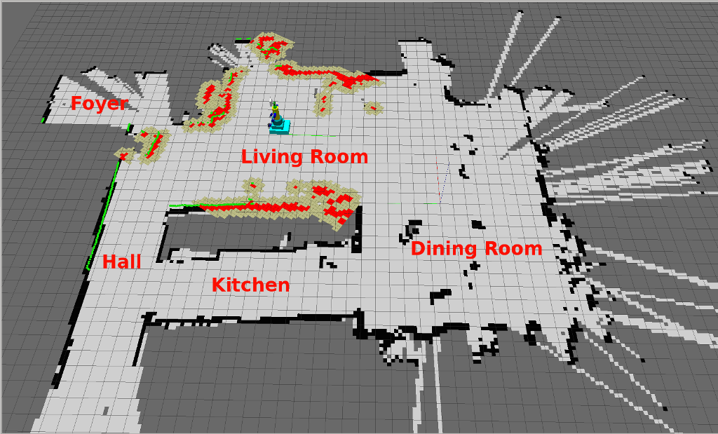
Prior knowledge
25 Predefined objects selected by technical committee, human hand manipulable.
Set to a location class (Eg, a cup assigned to kitchen table class)
Given access to the arena before competition starts (to map it out)

Slide 13
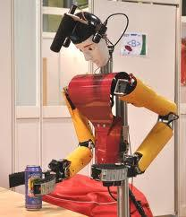

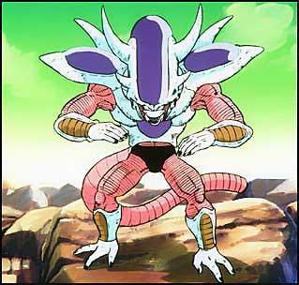
Organized in 3 Stages
Stage 1: Everyone is qualified. Includes “Open challenge 1” and Technical Challenge.
Stage 2: 10 teams or 50% of the qualified teams, includes “The Demo challenge”
Stage 3 (finals): 5 teams, consists of “Open challenge 2”

Slide 14
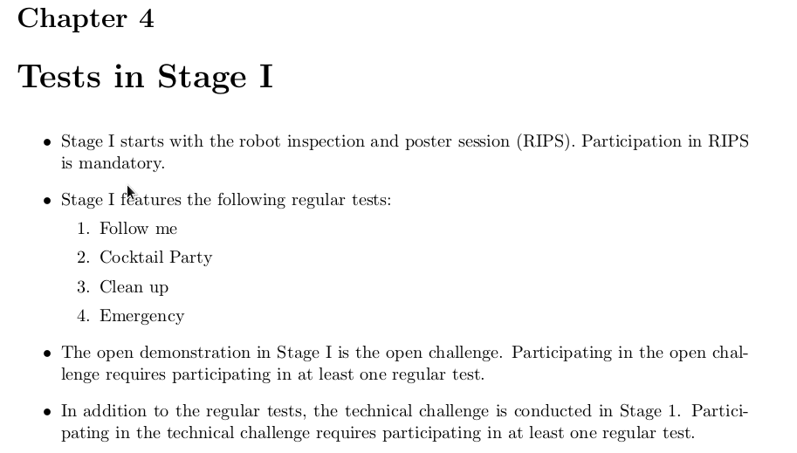
Stage 1: Logistics
Can compete in maximum 6 tests (not mandatory)
Maximum points per test: 1000
Negative points for not attending and failure to start autonomously
5 minute time limit per test

Slide 15

Stage 1: Our Approach

Slide 16
Stage 1: Tasks
First things first:
Inspection of our robot
Poster Session (Describing how we did it)
Robot has to register itself (With a pen or a stamp, sign its name)
Regular tasks:
Follow Me
Cocktail Party
Clean-up
Emergency Scenario

Slide 17
Stage 1: Autonomous Registration
3.1. The robots enter through the designated entry door, and move to the registration desk. The robots need to face the registration desk from within 2 m distance.
3.2. At the registration desk, the robots introduce themselves (stating their name and that of the team) and hand over the registration form.
3.3. When told to do so by the inspectors, a team member commands the robot(s) toleave the arena.
3.4. The robots leave through the designated exit door. While leaving, the inspectors hit the emergency button, and release it afterwards so that the robots leave the arena.

Slide 18
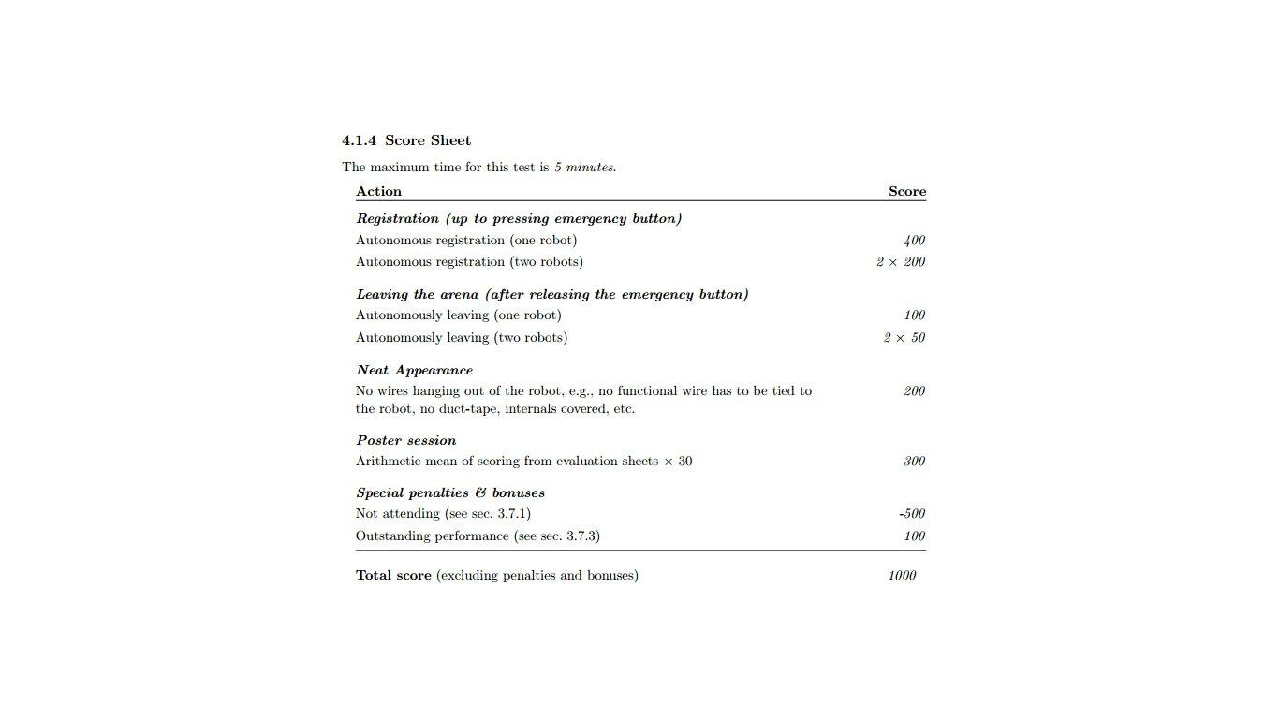
Stage 1: Scoresheet

Slide 19
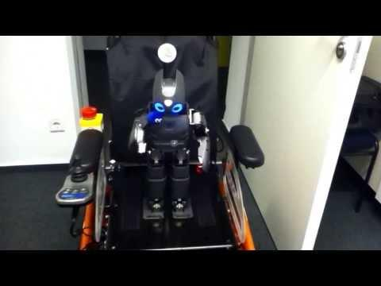
Autonomous Registration:

Slide 20
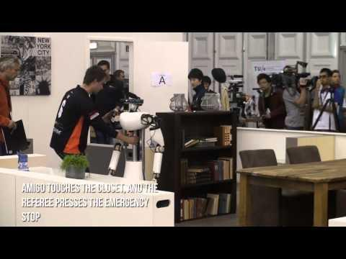
Stage 1: Regular Tasks
Cocktail Party: Robot serves beverages like a waiter/waitress
Clean Up: Robot must find and put away household objects
Follow Me: Robot has to follow a person through a crowd
Emergency Scenario: Smoke machine in arena with people, there is a “pretend fire” and the robot must navigate them outside of the house
Amigo doing follow me + beverage grabbing

Slide 21
Stage 1: Emergency Scenario...
Emergency Scenario:
Smoke machine in arena with people, there is a “pretend fire” and the robot must navigate them outside of the house
Must produce a pdf with:
Map of environment
Fire location on map
Image of source fire
Number and state of people in area
Position and images of people
Must be written to “black box” USB
In addition to navigating them out, alert the fire department by pdf.

Slide 22
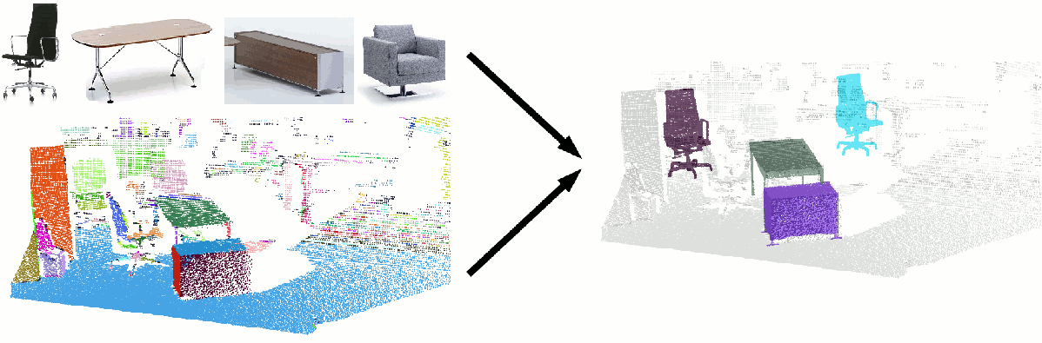
Stage 1: Technical Challenge
No points awarded
Testing State-of-The-Art solutions
A technical challenge award is given.
Last years was furniture recognition.
If we compete, our approach must have a paper written about it and have it published.

Slide 23
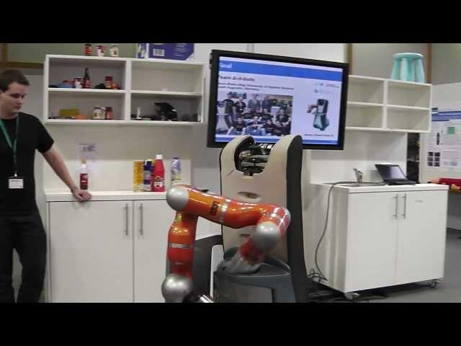
Stage 1: Open Challenge
Objective: Show off our technical capabilities and state of the art solutions

Slide 24
Stage 2: Overview
Logistics:
Tests:
E-GPSR (I’ll define that next slide)
Restaurant
Demo Challenge
2000 Points per test max
10 minute time limit (Except E-GPSR)
Best 50% of teams move forward to Stage 2.

Slide 25
Stage 2: Our Approach

Slide 26
Stage 2: E-GPSR
Endurance General Purpose Service Robot
Focuses on
The tasks
Logistics
Autonomy
Robot has to just chill out and take orders
Any order that a human can give/take is acceptable
Go into arena and wait for orders
Do the commands given by judges
3 Types of commands:
Proper, Unclear, and Erroneous
45 min test
Random commands by judges
No pre-defined actions allowed
3 teams testing in arena at once
Extremely difficult (But no problem for us)

Slide 27
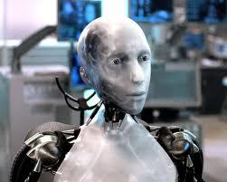
Stage 2: E-GPSR
Task:
Be as human like as possible

Slide 28
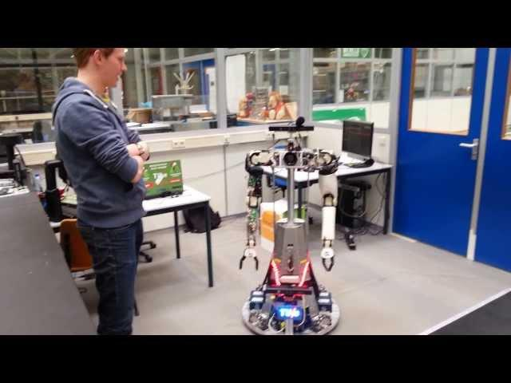
More Amigos: E-GPSR General Purpose Service Robot
As you can see, people like to show off grasping objects, which makes it seem like that’s all the robots can do. Here’s amigo in the E-GPSR.

Slide 29
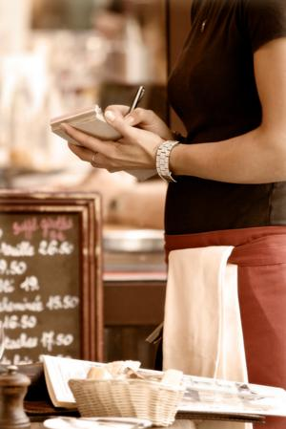
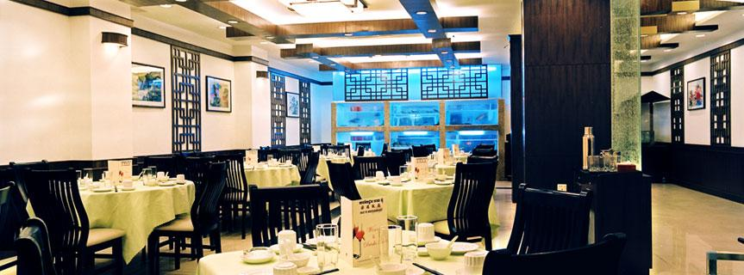
Stage 2: Restaurant
Task:
Act as a waitress/waiter would
Twist:
Takes place in public area
Could be arranged in real restaurant or shopping mall

Slide 30
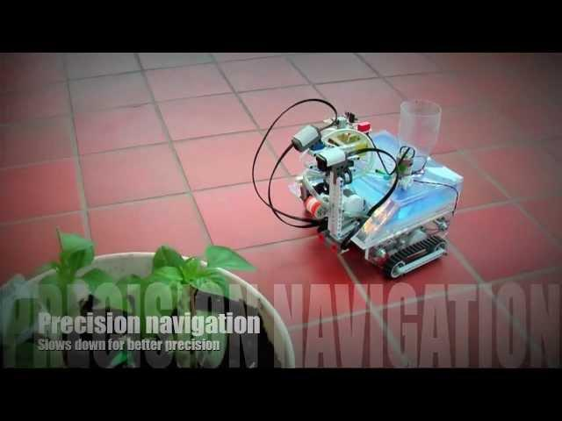
Stage 2: Demo Challenge
Our Goal: Something more interesting than grabbing an object (No disrespect, it is a hard task)

Slide 31

Final Stage:

Slide 32
Final Stage:
3 Teams Show off whatever skills they want

Slide 33
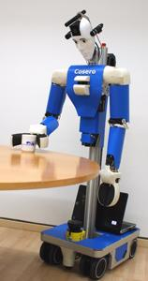
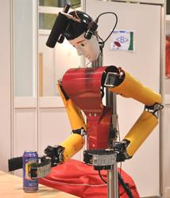
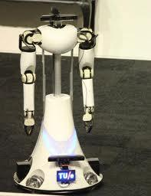
References:
1 2 3
[1][2] Cosero Robot & Dynamaid Robot http://www.ais.uni-bonn.de/nimbro/@Home/robots.html
[3] AMIGO Care Robot, http://www.techunited.nl/en/amigo
[4] RoboCup@Home Rule book 2013, http://www.robocupathome.org/rules
[5] Robot Operating System, http://wiki.ros.org/
[6] RoboCup@Home, http://www.robocupathome.org/

Slide 34
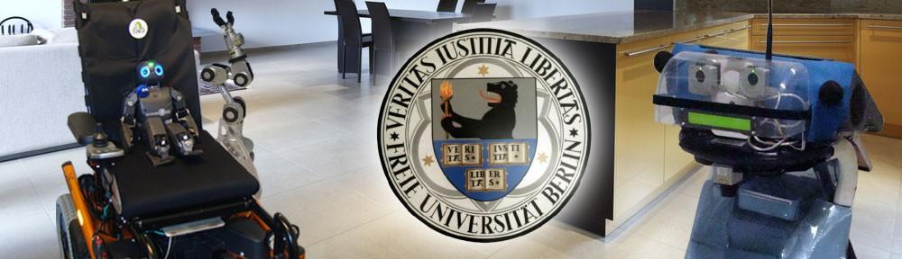
References:
[7] BerlinUnited@Home, http://athome.berlinunited.org/
7

